Slide 1
Information session TV and Online Content 8 March 2022
This info session will be recorded using WebEx for the purpose of publication on EACEA’s website. Only the presentations will be recorded: the Q&A sections will not be recorded
Please refer to the Data Protection Notice of the event for more information

Slide 3
TV and Online Content 2022 Call for proposals
Info session
European Education and Culture Executive Agency
8 March 2022

Slide 4
Agenda
Introduction: Policy context
Objectives and eligibility criteria
Q&A
BREAK
Assessment of proposals
How to apply – common errors
Q&A
Notes:
The objectives of the support to TV and online content are to
increase the capacity of audiovisual producers to develop and produce strong projects with significant potential to circulate throughout Europe and beyond,
and to
- facilitate European and international co-productions within the television and online sector.

Slide 5
Notes:
With an overall budget of 1,427 billion Euro, the MEDIA Strand of Creative Europe, will provide support for Europe’s audiovisual and film sectors in 4 main areas: Audience, Business, Content and Policy.
TV and online content belongs to the Content cluster of the MEDIA Strand.

Slide 6
Content cluster: Introduction
The actions in the Content cluster contribute to the objective of the Creative Europe MEDIA Strand to:
Encourage collaboration and innovation in the creation and production of high quality European audiovisual works
Focus on actions with a strong European added value, encouraging cross-border cooperation among producers and content developers and stimulating innovation in terms of content
Support cooperation amongst producers from different territory sizes and linguistic areas to ensure a level playing field, foster talent, whilst preserving and stimulating cultural diversity
Notes:
The actions in the Content cluster contribute to the objective of the CE MEDIA Strand to:
Encourage collaboration and innovation in the creation and production of high quality European audiovisual works
Focus on actions with a strong European added value, by encouraging cross-border cooperation and stimulating innovation in content
CE MEDIA wants to support cooperation between actors from different territory sizes and linguistic areas whilst – at the same time – preserving and stimulating cultural diversity.

Slide 7
Cross-cutting priorities
EU Green Deal – Support greening practices in the audiovisual ecosystem; incentivise the introduction of greening strategies for all parts of the audiovisual value chain
EU Gender Equality Strategy – for a diverse and inclusive audiovisual ecosystem; promote and reward diversity and inclusion strategies for the participants to the Creative Europe Programme
Notes:
The actions in the Content cluster contribute to the objective of the CE MEDIA Strand to:
Encourage collaboration and innovation in the creation and production of high quality European audiovisual works
Focus on actions with a strong European added value, by encouraging cross-border cooperation and stimulating innovation in content
CE MEDIA wants to support cooperation between actors from different territory sizes and linguistic areas whilst – at the same time – preserving and stimulating cultural diversity.

Slide 8
Content cluster: Introduction
European slate development
+
European mini-slate development
European co-development
Video games and immersive content development
TV and online content
Notes:
Content cluster covers 5 ‘actions’:
The well known slate development support, with its structuring effect on companies, which is now being joined by a very similar action reserved solely for companies established in low capacity countries, called mini-slate development.
Co-development, which is a new action, focusing on creative cooperation at an early stage.
The call for video games has been extended and will now also encompass immersive content development.
And the TV and online content action, which remains broadly similar to the TV action from the past but where nevertheless crucial changes have been made to open up the action to applications from countries which were less represented in the past and changes that allow applications to be submitted at an earlier stage.

Slide 9
TV and online content
Supporting high quality programming and innovation in content and financing
Notes:
Free picture from pixabay.com, photographer: Joshua_Willson

Slide 10
Objectives
Increase the capacity of audiovisual producers to develop and produce strong projects with significant potential to circulate throughout Europe and beyond
Facilitate European and international co-productions within the television and online sector
Notes:
The objectives of the support to TV and online content are to
increase the capacity of audiovisual producers to develop and produce strong projects with significant potential to circulate throughout Europe and beyond,
and to
- facilitate European and international co-productions within the television and online sector.

Slide 11
Aims – Funded activities
Strengthen the independence of producers in relation to broadcasters and digital platforms
Enhance collaboration between operators from different MEDIA countries
Support the production of high quality works aimed at
wide international distribution (linear and non-linear broadcasting)
promotion to a wide audience
Particular attention to projects with innovative aspects in contents and financing, showing a clear link with the distribution strategy
Notes:
The action aims to strengthen the independence of producers in relation to broadcasters and digital platforms and to enhance collaboration between operators, from different countries participating in the MEDIA Strand.
These operators include independent producers, broadcasters, digital platforms and sales agents.
So, we want to support the production of high quality programming aimed at wide international distribution (both linear and non-linear)
and that are promoted to a wide audience.
Particular attention will be given to projects presenting innovative aspects in the content and in the financing that show a clear link with the envisaged distribution strategies, so where we can see that the distribution strategy has been set up in view of the innovative aspects in content and financing.

Slide 12
Timetable and budget
Budget: 22 000 000
Notes:
Back to two deadlines. High budget of 22M

Slide 13
Call 2022: Changes in the Call text
Max. co-funding rate increased from 15% to 20% for all genres
Greening: encouragement to use greening consultants to reduce the environmental impact of productions and shootings
Clarification of certain paragraphs, most specifically on what can be considered as binding letters of commitment
Return to the application to be submitted at the latest on the 1st day of principal photography
« Applicant must be majority producer » moved from consortium composition to eligible participants

Slide 14
Eligible participants
Application by a single applicant or a consortium
Main applicant = coordinator
Other applicants = partners or affiliated entities of coordinator/partners
All applicants: Independent European audiovisual production companies
The coordinator (i.e. main applicant) must be the majority producer of the work in terms of rights (if equal distribution of rights, the coordinator must be appointed as delegate producer)
Notes:
In order to be eligible, applicants must be Independent European audiovisual production companies.
Proposals may be submitted by a single applicant or as part of a consortium.
In the case of a consortium -> The coordinator must be the majority producer of the work in terms of rights. In case of a 50%-50% co-production, the coordinator must be designated by the partner as delegate producer.

Slide 15
Eligible participants
Independent: no majority control by an audiovisual media service provider, either in shareholding or commercial terms
Majority control: more than 25% of share capital held by a single audiovisual media service provider (50% in case of several AVMS providers)
European: established in one of the countries participating fully in the MEDIA strand
and owned directly or indirectly, wholly or by majority participation, by nationals from such countries
for publicly listed companies: location of the stock exchange determines the nationality
Audiovisual production companies: the company’s main objective and activity is audiovisual production
Notes:
What do we mean when we say Independent European audiovisual production companies?
-> Independent, means that there should not be majority control by an audiovisual media service provider, either in shareholding or commercial terms.
Majority control: is when more than 25% of the share capital is held by a single audiovisual media service provider or 50% in case of several audiovisual media service providers
-> European means that they should be established in one of the countries participating in the MEDIA Strand
And owned directly or by majority participation by nationals from MEDIA countries
for publicly listed companies, the location of the stock exchange will be taken into account to determine their nationality
-> And finally, Audiovisual production company means that the company’s main objective and activity is audiovisual production

Slide 16
Eligible activities
Production activities for both one-off or series
Intended primarily for TV or online exploitation
Works designed to be a series must be submitted as a series
Minimum length:
Drama films: 90 minutes
Animation: 24 minutes
Creative documentary: 50 minutes
Notes:
-> Eligible activities should be production activities of one-off or series.
-> They must be primarily intended for TV or online exploitation
-> Works which are designed to be a series with a joint marketing strategy have to be submitted as a series. Single episodes of a series should not be split into separate applications.
-> They also should have a minimum length in terms of total duration whish is
For Drama the total duration should be minimum 90 mins
For Animation it should be minimum 24 mins
And for Creative Documentaries it should be minimum 50 mins
You will notice the limitations for sequels or second and further seasons have been removed

Slide 17
Eligible activities
First day of principal photography: at the earliest on the day of submission of the application
Duration of projects: 24 months, or 36 months for series of more than 2 episodes (extensions possible, if justified and after amendment)
Default: after signature of the Grant Agreement
Retroactivity to date of submission with justification + approval
Produced with the significant participation of professionals who are nationals and/or residents of MEDIA countries
Notes:
The first day of principal photography (or start of animation for animation projects) shall take place at the earliest on the day of submission of the application.
The duration of the projects is 24 months or 36 months in case of series of more than 2 episodes (extensions possible, if justified and after amendment)
The starting date of the eligibility period is by default set after the signature of the Grant Agreement.
The eligibility period may start on the date of submission of the application when justified and subject to approval by the granting authority
-> But careful because costs can only be eligible after the GA signature or from the date of submission of the application in duly justified cases.
The work must be produced with the significant participation of professionals who are nationals and/or residents of countries participating in the MEDIA Strand.

Slide 18
Eligible activities
Fiction |  | Documentary |  | Animation
Director/Project leader | 3 | Director/Project leader | 3 | Director | 3
Author/(Script)writer/Creator | 3 | Author/(Script)writer/Creator | 3 | Author/(Script)writer/Creator | 3
Actor 1 | 2 | Composer | 1 | Composer | 1
Actor 2 | 2 | Production designer | 1 | Editor | 1
Actor 3 | 2 | Director of photography | 1 | Sound | 1
Composer | 1 | Editor | 1 | Storyboard artist | 2
Production designer | 1 | Sound | 1 | Character designer | 2
Director of photography | 1 | Shooting location | 1 | Animation supervisor | 2
Editor | 1 | Post production location | 1 | Art(istic) director | 1
Sound | 1 |  |  | Technical director | 1
Shooting location | 1 |  |  | Studio location | 1
Post production location | 1 |  |  | Post production location | 1
Total | 19 | Total | 13 | Total | 19
Notes:
“Significant participation” is defined as having more than 50% of the points on the basis of this table.
The points that you see, are given when the professional is a national or resident of a MEDIA country.
You will see the table is split between the different genres reflecting the roles that are taken into consideration in each genre.

Slide 19
Eligible activities
Confirmed involvement of min. 2 broadcasting (linear and non-linear) companies from 2 MEDIA countries
Contracts or binding LOC (incl. conditions of financial involvement, licence price and period)
NOT accepted: letters from broadcasters that:
show a preliminary interest
are subject to final approval
agree to buy the work once produced
Notes:
-> The project must involve at least 2 broadcasting companies (linear and non-linear), from 2 countries participating in the MEDIA Strand.
-> The broadcasters’ involvement must be supported by contracts or signed binding letters of commitment specifying the conditions of their financial involvement, including the licence price and licence period. Letters showing a preliminary interest, letters of intent subject to final approval and letters agreeing to possibly buy the work once produced are not considered as binding letters of commitment.
Why only contracts or signed binding letters of commitment?
It gives a much clearer picture of the actual situation of the project
It allows to create an equal footing for the evaluation
e.g. how to compare an application with 15 very vague and uncertain LOI and an application with 3 very strong commitments?
It allows to speed up the analysis and evaluation

Slide 20
Frequent errors related to eligibility criteria
Not accepted as binding LOC: Documents entitled ‘letter of commitment’ or ‘deal memo’ but where the text clearly only states an intent to acquire
« We confirm our (preliminary) interest … »
« We are interested in the possibility of acquiring … »
« The participation of XYZ in the project is subject to the approval of … »
« We reserve the right not to conclude …until we have screened and approved the final version »
« XYZ confirms their commitment to license the series, once the series has been fully financed, completed to a good technical standard … XYZ’s contribution to the financing is estimated at XXX EUR and is subject to … »
« we confirm that – subject to general approval and financial negotiation – the ABC is interested in developing and co-producing … »
« this letter of interest may in no way be considered to be a contract for the anticipated acquisition of rights … »
It is the content of the document that counts, NOT the title
Notes:
-> The project must involve at least 2 broadcasting companies (linear and non-linear), from 2 countries participating in the MEDIA Strand -> This has been reduced from previous call, where the minimum was 3 broadcasting companies from 3 MEDIA countries.
-> The broadcasters’ involvement must be supported by contracts or signed binding letters of commitment specifying the conditions of their financial involvement, including the licence price and licence period. Letters agreeing to possibly buy the work once produced are not considered as binding letters of commitment.

Slide 21
Frequent errors related to eligibility criteria
Also not accepted as signed binding LOC:
E-mails
Letters with an expiration date that has passed
Letters without an amount
Letters that do not stipulate the duration of the exploitation rights
These ‘potential’ sources of financing should NOT be mentioned in the Production Financing Structure, and documents should NOT be provided in the annex ‘Confirmed sources of financing …’ but CAN go in the annex ‘Letters of intent for distribution’
Accepted: signed binding LOC with required elements only subject to signature of a full agreement
The better this is respected, the quicker the evaluation, the quicker the decision!
Notes:
-> The project must involve at least 2 broadcasting companies (linear and non-linear), from 2 countries participating in the MEDIA Strand -> This has been reduced from previous call, where the minimum was 3 broadcasting companies from 3 MEDIA countries.
-> The broadcasters’ involvement must be supported by contracts or signed binding letters of commitment specifying the conditions of their financial involvement, including the licence price and licence period. Letters agreeing to possibly buy the work once produced are not considered as binding letters of commitment.

Slide 22
Eligible activities
Confirmed involvement of min. 2 broadcasting (linear and non-linear) companies from 2 MEDIA countries
Licence period:
Pre-sale: max. 7 years
Co-production: max. 10 years
Co-production: only if
financial investment higher than average investment of other partners
involved in organisation and economic handling
Must be respected by ALL broadcasters
Notes:
-> The exploitation rights licensed to the broadcasting companies participating in the production have to revert to the producer after a maximum license period of:
7 years if the broadcaster’s participation takes the form of a pre-sale
10 years if the broadcaster’s participation also takes the form of a co-production.
In the case of a co-production deal, the binding letter of commitment or the contract between the producer and the broadcaster must clearly specify the price and licence term for the pre-sale of the exploitation rights and the conditions for the co-production. A co-production between a broadcaster and a TV producer is accepted only if the broadcaster makes a financial investment higher than the average investment of the other partners and is involved in the organisation and economic handling of the production.

Slide 23
Frequent errors related to eligibility criteria
Maximum licence period for all broadcasters involved in the production
Not accepted:
« XYZ shall have the option to relicense the contractual rights for further 10 years against payment of XXX EUR »
« XYZ shall own the exploitation rights exclusively for 5 years and non-exclusively for 7 years »
«the exploitation rights are granted for an indefinite period »
«the linear broadcasting rights will be acquired for 5 years as a minimum » (without stating the maximum)
Notes:
-> The project must involve at least 2 broadcasting companies (linear and non-linear), from 2 countries participating in the MEDIA Strand -> This has been reduced from previous call, where the minimum was 3 broadcasting companies from 3 MEDIA countries.
-> The broadcasters’ involvement must be supported by contracts or signed binding letters of commitment specifying the conditions of their financial involvement, including the licence price and licence period. Letters agreeing to possibly buy the work once produced are not considered as binding letters of commitment.
-> The exploitation rights licensed to the broadcasting companies participating in the production have to revert to the producer after a maximum license period of:
7 years if the broadcaster’s participation takes the form of a pre-sale
10 years if the broadcaster’s participation also takes the form of a co-production.
In the case of a co-production deal, the contract between the producer and the broadcaster must clearly specify the price and licence term for the pre-sale of the exploitation rights and the conditions for the co-production. A co-production between a broadcaster and a TV producer is accepted only if the broadcaster makes a financial investment higher than the average investment of the other partners and is involved in the organisation and economic handling of the production.

Slide 24
Eligible activities
Min. 40% of financing guaranteed from third party sources:
Supported by signed binding LOC, mentioning:
amount of financial contribution
nature of the rights sold
licence period
Broadcasters, distributors, funds and equity investors
Tax shelter: acccepted if confirmed by supporting documents from the competent bodies
NOT: producer’s and co-producers’ own investment
NOT: MEDIA grant
If any aspect is missing → removed from financing plan
Notes:
A minimum of 40% of the financing of the total estimated production budget must be guaranteed from third party sources of finance (either through direct financing or by advance rights sales) -> change from previous Call (used to be 50%).
Third party sources of finance must be proven by recent signed binding letters of commitment, mentioning the action title, the exact amount of the financial contribution, the nature of the rights sold and the license period.
- Contributions from broadcasters, distributors, funds and equity investors are considered as third party sources of finance.
- A tax shelter might be accepted as a third party source of finance only if confirmed by supporting documents from the competent bodies.
- The producer’s and co-producer’s own investment and the requested MEDIA grant are not considered as a third party source of finance and do not enter in the calculation of the minimum 40% of financing in place.
If the action is co-produced by several production companies, a co-production contract (or deal-memo) indicating the share of financing, share of rights, share of costs and share of revenues, has to be submitted with the application. Simple letters indicating a co-producer’s financial contribution without further details concerning the co-production deal will not be taken into consideration.
A minimum of 50% of the total estimated financing must come from countries participating in the MEDIA Strand.

Slide 25
Eligible activities
Co-production with other production companies: contract or deal-memo required, indicating:
share of financing
share of rights
share of costs
share of revenues
Min. 50% of total estimated financing must come from MEDIA countries
If any aspect is missing → removed from financing plan
Notes:
A minimum of 40% of the financing of the total estimated production budget must be guaranteed from third party sources of finance (either through direct financing or by advance rights sales) -> change from previous Call (used to be 50%).
Third party sources of finance must be proven by recent signed binding letters of commitment, mentioning the action title, the exact amount of the financial contribution, the nature of the rights sold and the license period.
- Contributions from broadcasters, distributors, funds and equity investors are considered as third party sources of finance.
- A tax shelter might be accepted as a third party source of finance only if confirmed by supporting documents from the competent bodies.
- The producer’s and co-producer’s own investment and the requested MEDIA grant are not considered as a third party source of finance and do not enter in the calculation of the minimum 40% of financing in place.
If the action is co-produced by several production companies, a co-production contract (or deal-memo) indicating the share of financing, share of rights, share of costs and share of revenues, has to be submitted with the application. Simple letters indicating a co-producer’s financial contribution without further details concerning the co-production deal will not be taken into consideration.
A minimum of 50% of the total estimated financing must come from countries participating in the MEDIA Strand.

Slide 26
Eligible activities
Ineligible projects
Live recordings, TV games, talk shows, cooking shows, magazines, TV-shows, reality shows, educational, teaching and « how to » programmes
Documentaries promoting tourism, « making-of », reports, animal reportages, news programmes and « docu-soaps »
Projects including pornographic or racist material or advocating violence
Works of a promotional nature
Institutional productions to promote a specific organisation or its activities
Music videos and video-clips
Projects already financed by Eurimages
Productions originally intended as cinema works
Notes:
List of ineligible projects are defined in the Call document.
Please pay attention to the fact that the following are ineligible:
Projects already financed by Eurimages
Productions originally intended as cinema works (e.g. several theatrical distributors and/or an international sales agent involved)

Slide 27
Financing
Customised lump sum: output-based lump sum established after applying a 20% co-financing rate to a verified and approved detailed budget
Maximum EU grant:
Creative documentary: EUR 300 000
Animation: EUR 500 000
Drama: depends on eligible production budget
< 10M: EUR 500 000
10M – 20M: EUR 1M
> 20M: EUR 2M
Notes:
The MEDIA grant will take the form of a customised lump sum
This means that applicants will submit their applications with an estimated project budget. The grant amount will be established on the basis of the estimated project budget and application.
Contracted projects will receive the final grant on the basis of the produced final product, which will no longer be linked to final costs.
Co-financing rate of 20%
The maximum EU grant is:
300.000 EUR for Creative documentaries
500.000 EUR for Animation
For drama: 3 different maximum EU grants up to 2M, depending on the eligible production budget:
500.000 EUR if elig. budget less than 10M
1M EUR if elig. budget between 10-20M EUR
2M EUR if elig. budget more than 20M EUR
Pre-financing: normally 60% (all payments via coordinator)

Slide 28
Financing
Costs of partners and affiliated entities of coordinator/partners eligible. An affiliated entity is:
any legal entity that is
under the direct or indirect control of a participating beneficiary (daughter)
OR under the same direct or indirect control as the participating beneficiary (sister)
OR directly or indirectly controlling a participating beneficiary (mother)
Legal entity A controls legal entity B if:
A, directly or indirectly, holds more than 50% of the nominal value of the issued share capital or a majority of the vothing rights of the shareholders or associates of B, or
A, directly or indirectly, holds in fact or in law the decision-making powers in B
Notes:
Basically, companies belonging to a same group. In the application form, the following details on control can be found:
Legal entity A controls legal entity B if:
A, directly or indirectly, holds more than 50% of the nominal value of the issued share capital or a majority of the voting rights of the shareholders or associates of B, or
A, directly or indirectly, holds in fact or in law the decision-making powers in B.
The following relationships between legal entities shall not in themselves be deemed to constitute controlling relationships:
the same public investment corporation, institutional investor or venture-capital company has a direct or indirect holding of more than 50% of the nominal value of the issued share capital or a majority of voting rights of the shareholders or associates
the legal entities concerned are owned or supervised by the same public body.
To be honest, we need to feel our way around this new concept as well. My understanding is that affiliated entities will be validated (PIC validation) by REA, as all other companies, and they will confirm the existence of this 'control'.

Slide 29
Financing
Affiliated entities:
participate in the action with similar rights and obligations as beneficiaries, but do not sign the Grant Agreement (i.e. do not become beneficiaries themselves)
can get a part of the EU grant (via the coordinator) and must hence comply with the call conditions and be validated (must have a PIC)
Notes:
Basically, companies belonging to a same group. In the application form, the following details on control can be found:
Legal entity A controls legal entity B if:
A, directly or indirectly, holds more than 50% of the nominal value of the issued share capital or a majority of the voting rights of the shareholders or associates of B, or
A, directly or indirectly, holds in fact or in law the decision-making powers in B.
The following relationships between legal entities shall not in themselves be deemed to constitute controlling relationships:
the same public investment corporation, institutional investor or venture-capital company has a direct or indirect holding of more than 50% of the nominal value of the issued share capital or a majority of voting rights of the shareholders or associates
the legal entities concerned are owned or supervised by the same public body.
To be honest, we need to feel our way around this new concept as well. My understanding is that affiliated entities will be validated (PIC validation) by REA, as all other companies, and they will confirm the existence of this 'control'.

Slide 30
Q&A

Slide 31
STRETCH YOUR LEGS … TAKE A CUP OF COFFEE … BACK IN …

Slide 32
How are proposals assessed?

Slide 33
How are the proposals assessed?
ADMISSIBILITY CRITERIA
Submission requirements
ELIGIBILITY CRITERIA
Eligible participants
Eligible activities
FINANCIAL AND OPERATIONAL CAPACITY AND EXCLUSION
Expertise and solvency
Situations of exclusion (eg bankruptcy)
AWARD CRITERIA
Evaluation of the quality of the proposal

Slide 34
Admissibility criteria
Submit before the deadline (No late submissions)
BUT: you can resubmit revised versions up till the deadline
Submit electronically via the Funding & Tenders Portal Electronic Submission System (No applications by email/on paper)
Submit using the templates provided in the Submission System (Not the templates on the topic page -> for info only)
Submission only possible when complete (all mandatory parts and mandatory annexes)
Respect the page limitations (Part B max. 70 pages – does not include the other annexes)

Slide 35
Financial and operational capacity
Financial capacity: have stable and sufficient resources to implement the project and contribute their share
Based on annual accounts (to be uploaded in Participant Portal in case of selection)
Operational capacity: have the know-how, qualifications and resources to implement the project
evaluated based on ‘project management’ criterion
Notes:
Next to the eligibility criteria, applications will be verified against a set of other conditions.
First of all, we will verify whether the applicants have the financial capacity to implement the action. This means that they must have stable and sufficient resources to implement the project and contribute their share of the costs.
In case of a weak financial capacity, we are looking into the possibility to pay a prefinancing in instalments rather than to require a bank guarantee. This would mean that selected companies would get a smaller pre-financing at first, but that a second pre-financing could be released after the submission of a progress report, which would give us the assurance that the project is on the right track.
Second, we will also evaluate whether the company has the necessary know-how, qualifications and resources to implement the project, the so-called operational capacity. This will, in general, be evaluated based on the ‘project management’ criterion.

Slide 36
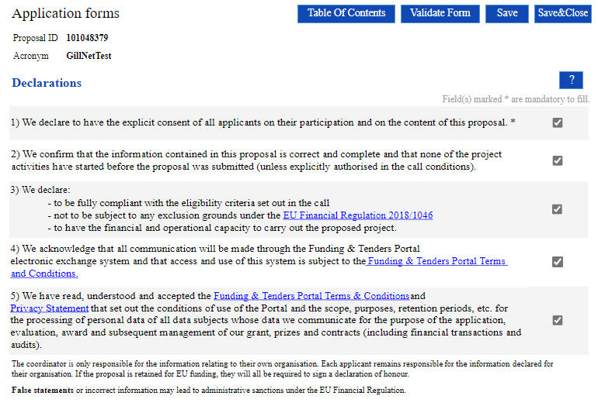
Exclusion - declaration
Exclusion criteria are based on a declaration in Part A of the application.
Read each declaration carefully
Amongst others: if the applicants misrepresented information required as a condition for participating or failed to supply that information
Notes:
And lastely, applicants will also be checked against exclusion criterion. Important to highlight is that, in case applicants misrepresented information in their application or if they failed to supply information, they will be excluded from the selection.

Slide 37
Award criteria
Common structure
Relevance (30 points)
Quality of content and activities (35 points)
Project management (5 points)
Dissemination (30 points)
Overall threshold: 70/100
Consult breakdown of the criteria in the Call and keep all elements in mind when preparing your application
Notes:
-> The award criteria -> 4 criteria sections common to all of MEDIA
-> An overall quality threshold has been established, meaning that an application needs to achieve a minimum of 70 out of 100 points.
Proposals that pass the overall threshold will be considered for funding — within the limits of the available call budget. Other proposals will be rejected.
Even if a proposal doesn’t reach the threshold, even if there is still available budget left, they cannot be selected.

Slide 38
Award criteria
Relevance (30 points)
European dimension of the financing of the project (15 points)
European co-production (5 points)
Adequacy of the strategies presented to ensure a more sustainable and environmentally-respectful industry (5 points)
Adequacy of the strategies to ensure gender balance, inclusion, diversity and representativeness, either in the project/content or in the way of managing the activity (5 points)
Notes:
The first award criterion focuses on the relevance of the project in relation to the call’s objective and targeted projects -> 30 points
It has an increased focus on geographic and linguistic diversity of the partners involved, but also on partners coming from different market sizes under the 1st and 2nd sub-criteria which look at
The European dimension of the financing of the project (15 points)
and
TheEuropean co-production (5 points)
It also takes into account the sub-criteria addressing the transversal priorities common to all of MEDIA:
Adequacy of the strategies presented to ensure a more sustainable and environmentally-respectful industry (5 points)
Adequacy of the strategies to ensure gender balance, inclusion, diversity and representativeness, either in the project/content or in the way of managing the activity (5 points)

Slide 39
Award criteria
Quality of content and activities (35 points)
Artistic quality of the project (15 points)
Overall quality and financing of the project (5 points)
Potential to reach audiences at European and international level (15 points)
Notes:
The 2nd award criterion looks at he quality of the project and the potential to reach audiences -> 35 points
Firstly, the artistic quality of the project is looked at for 15 points
Then the overall quality and financing of the project (5 points)
And at the potential to reach audiences at European and international level (15 points)

Slide 40
Award criteria
Project management (5 points)
The distribution of the roles and responsibilities of the production and creative team, including the adequacy of the collaboration in relation to the objectives of the project
For animation projects, the location of the animation work will be assessed to encourage the use of European studios
Notes:
The third criterion, which is also used to assess the operational capacity of the company, looks at the way the company wants to implement the project.
I would like to draw your attention to the fact that for animation, the location of the animation work will be assessed.
This has been put in place to encourage the use of European studios.

Slide 41
Award criteria
Dissemination (30 points)
Quality of the distributor’s involvement (10 points)
Quality of the distribution strategy (15 points)
Quality of the promotion and marketing strategy (5 points)
Notes:
Finally the last award criterion looks at the Quality of the distributor’s involvement and distribution strategy and quality of the promotion and marketing strategy -> 30 points

Slide 42
How to apply?

Slide 43
How to apply
Any application must consist of:
Part A: Administrative information (but also duration and max. EU grant)
Part B: ‘Technical’ description of the project (information that allows to assess the award criteria) + definition of work packages and deliverables
Part C: KPI-related data linked to the applicants
PDF with information about film(s)/work(s) to be submitted for funding: to be generated via the MEDIA Database
Mandatory annexes (downloaded together with Part B)
Notes:
Part A: contains administrative information about the participants (future coordinator, beneficiaries and affiliated entities) and the summarised budget for the project -> to be filled in directly online
Part B — contains the technical description of the project -> to be downloaded from the Portal Submission System, completed and then assembled and re-uploaded as a PDF in the system
-> This will be common for the whole of MEDIA. This means that applicants must pay special attention to reply to the questions that are addressed to them for the specific scheme they are applying for!
Part C (to be filled in directly online) containing additional project data
MEDIA Film DB: information on the work

Slide 44
How to apply
Mandatory annexes:
Detailed budget table (mandatory template)
Creative presentation of the project, including link to trailer/teaser
Production Financing Structure (mandatory template)
Confirmed sources of financing and (if applicable) co-production contract(s) ENSURE COHERENCE WITH PRODUCTION FINANCING STRUCTURE
Letters of intent for distribution
Information on independence and ownership and control: breakdown of shareholding per company, including affiliated entities (mandatory template)
Notes:
detailed budget table -> mandatory excel template available in the Submission System
detailed description of the project, including a link to a trailer/teaser -> artistic material related to the project, e.g. director’s note, booklet, graphic presentation, sample of script, etc.
Production Financing Structure -> mandatory Excel template to present the overview of all the confirmed sources of financing to cover the total production budget
confirmed sources of financing and, if applicable, co-production contract(s) -> scan of all the supporting documents for the confirmed sources of financing and co-productions, to be scanned in the same order as they are mentioned in the Production Financing Structure. Please consult the instructions in the template of the Production Financing Structure and the section on ‘Eligible Activities’ below to determine what can be considered as confirmed sources of financing).
other letters of intent related to the distribution and financing strategies (scan of distribution and financing documents that do not meet the criteria in order to be considered ‘confirmed’). These can be taken into consideration to assess the distribution potential.
Declaration on ownership and control

Slide 45
How to apply
Part B: A correct definition of work packages and deliverables are crucial elements in order to obtain the full EU grant
Structure of work packages (mandatory):
WP 1: Project management and coordination
WP 2: Pre-production (only if applicable)
WP 3: Production
WP 4: Post-production, prints and delivery
WP 5: Communication and dissemination
Notes:
The structure of the Work Packages is as follows:
WP1: Management and coordination
For example it concerns co-production deals, securing of distribution and the management of the project itself
WP2: Pre-production (if applicable)
If the project has already entered into production, this will not be applicable
WP3: Production
WP4: Post-production & prints and delivery
WP5: Communication and dissemination

Slide 46
How to apply
Deliverables:
Will need to be submitted during the lifetime of the project
Be realistic: reduction of EU grant in case of partial implementation (request amendment if needed)
Notes:
As mentioned earlier, the structure of the minimum deliverables that will need to be submitted, is clearly defined in the Call document.
WP 1 Project management and coordination: Updated Production Financing Structure and copy of contract signed with main broadcaster
WP 2 Pre-production: Declaration on 1st day of principal photography
WP 3 Production: Declaration on the end of shooting
WP 4 Post-production, prints and delivery: Acceptance letter of the material from the main broadcaster and link to produced material
WP 5 Communication and dissemination: Promotion material (trailer, poster, stills, etc.) and most recent royalty statement from sales agent
Interoperable Standard Identifier (such as ISAN or EIDR)

Slide 47
How to apply
Minimum mandatory deliverables:
WP 1: Updated Production Financing Structure and copy of contract signed with main broadcaster
WP 2: Declaration on 1st day of principal photography
WP 3: Declaration on the end of shooting
WP 4: Acceptance letter of the material from the main broadcaster and link to produced material
WP 5: Promotion material (trailer, poster, stills, etc.) and most recent royalty statement from sales agent
Interoperable Standard Identifier (such as ISAN or EIDR)
Notes:
As mentioned earlier, the structure of the minimum deliverables that will need to be submitted, is clearly defined in the Call document.
WP 1 Project management and coordination: Updated Production Financing Structure and copy of contract signed with main broadcaster
WP 2 Pre-production: Declaration on 1st day of principal photography
WP 3 Production: Declaration on the end of shooting
WP 4 Post-production, prints and delivery: Acceptance letter of the material from the main broadcaster and link to produced material
WP 5 Communication and dissemination: Promotion material (trailer, poster, stills, etc.) and most recent royalty statement from sales agent
Interoperable Standard Identifier (such as ISAN or EIDR)

Slide 48
Common errors in applications
Acronym and short summary (to be encoded when starting the application)
Acronym: helpful if it refers to the company/project (i.e. not TV2022 for example)
Short summary (abstract): must deal with objectives, activities, type and number of persons benefiting from the project, expected results, type and number of outputs to be produced. Do not include confidential info. The synopsis of the project goes in the MEDIA Database
Notes:
The expected impact remains similar to what we had in the past, namely an increase in high quality European productions for TV and online distribution, an increase in the number of co-productions and enhanced cooperation between operators from MEDIA countries, and an increased audience for European works.

Slide 49
Common errors in Part A
Partners not or incorrectly encoded in Part A
Only COO encoded in Part A, whilst in budget and Part B a co-production partner is identified as co-beneficiary
Partner encoded as affiliated entity whilst it is not an AE of the COO or identified partners
Partner encoded in Part A but with 0 EUR budget (is it a co-beneficiary?)
Ensure coherence between Part A, Part B and estimated budget at all times!

Slide 50
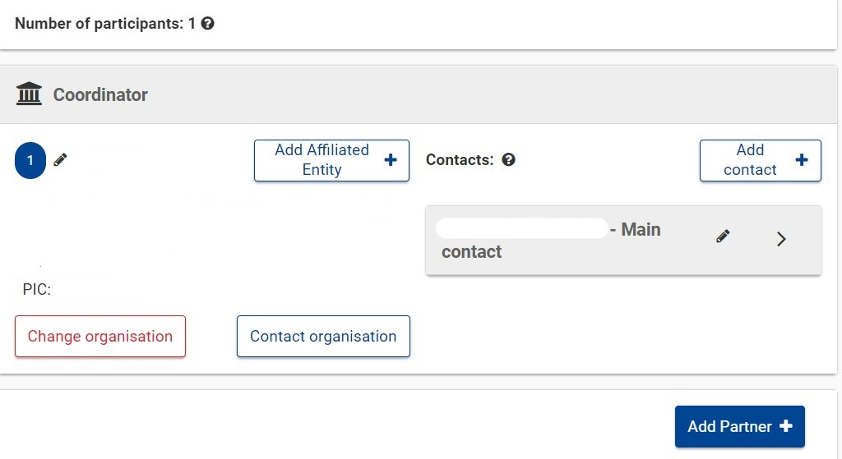
Key actors in the application
Coordinator (COO): main applicant
Partner (PA): co-beneficiary of the grant
Affiliated entity: entity linked to one of the applicants (COO or PA) and taking part in the action – to be encoded at the level of either the COO or the PA (the linked entity)
Submission: only by main contact and other contact with full access right of the COO
For both COO and PA, a main contact (intermediary with our services) needs to be identified. Other contacts (either with full access or read-only access) can be added
Notes:
Basically, companies belonging to a same group. In the application form, the following details on control can be found:
Legal entity A controls legal entity B if:
A, directly or indirectly, holds more than 50% of the nominal value of the issued share capital or a majority of the voting rights of the shareholders or associates of B, or
A, directly or indirectly, holds in fact or in law the decision-making powers in B.
The following relationships between legal entities shall not in themselves be deemed to constitute controlling relationships:
the same public investment corporation, institutional investor or venture-capital company has a direct or indirect holding of more than 50% of the nominal value of the issued share capital or a majority of voting rights of the shareholders or associates
the legal entities concerned are owned or supervised by the same public body.
To be honest, we need to feel our way around this new concept as well. My understanding is that affiliated entities will be validated (PIC validation) by REA, as all other companies, and they will confirm the existence of this 'control'.

Slide 51
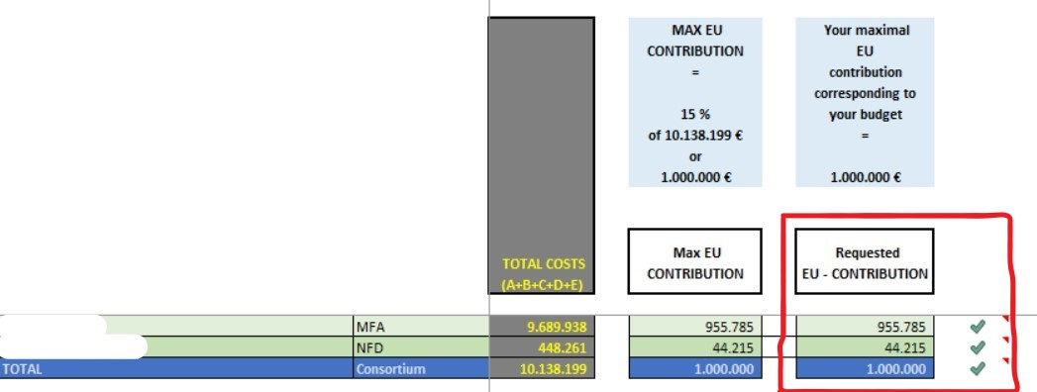
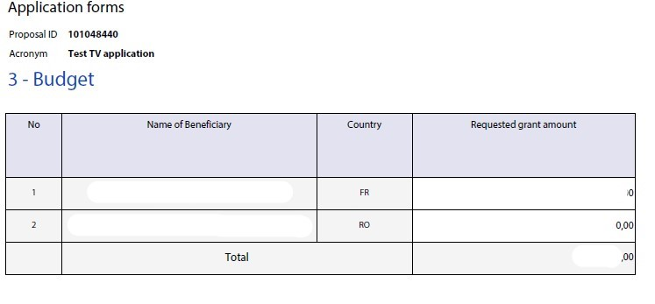
Common errors in Part A
Budget (EU grant requested) incorrectly encoded in Part A
Entire production budget instead of EU grant requested
Different amounts than in the budget, either with same total (but different repartition) or with different total
Entire EU grant requested for COO, 0 for PA
Zero(s) too much or too little (e.g. 10M instead of 1M)
$$=$$

Slide 52
Common errors in estimated budget
Max. grant amount and max. co-financing rate incorrectly encoded in ‘Instructions’ sheets → incorrect calculation of the max. EU contribution in the ‘Proposal Budget’ sheet → incorrect requested EU grant !!!!
Do not forget to break the type of employees down
For elements to be encoded in ‘Instructions’, check section 10 of the Call
Max. grant amount = EUR 300.000/500.000/1M/2M depending on the type of project
Max. co-financing rate = 20%

Slide 53
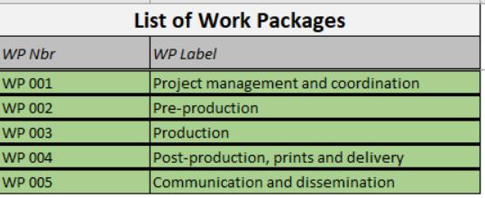
Common errors in estimated budget
Encode partners correctly and apply changes!
Encode work packages correctly and apply changes!
Partnership in Part A
Work packages in Part B

Slide 54
Common errors in estimated budget
Only encode eligible costs! (≠ entire production budget, ≠ costs incurred by others outside the consortium, ≠ costs incurred outside eligibility period)
When encoding the budget, clarify the units used via the ‘Any comments’ sheet

Slide 55
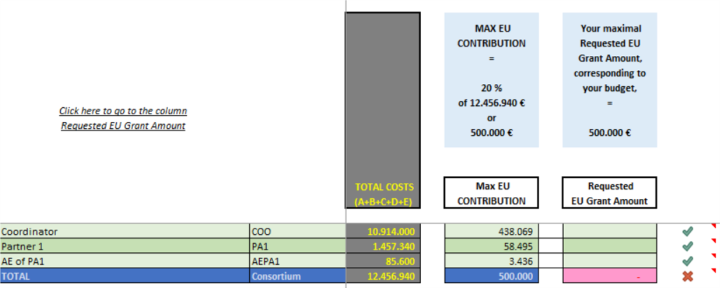
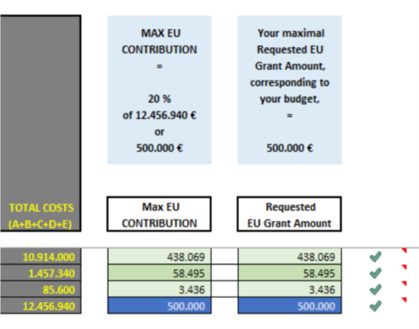
Common errors in estimated budget
Do not forget to fill in the Requested EU Grant Amount and make sure that it corresponds to the budget in Part A
Amounts in Part A

Slide 56
Common errors in Part B
Use the template!!! (goes for all mandatory templates)
Do NOT put it in another format
Do NOT add other types of documents such as CVs
Do NOT leave mandatory sections blank (no info = 0)
Provide information in the correct section
Ensure that the info is coherent with the rest of the documents in the application
Ensure that it is readable
Notes:
Also here, applicants must be Independent European audiovisual production companies.
Proposals may be submitted by a single applicant or as part of a consortium.
In the case of a consortium -> The coordinator must be the majority producer of the work in terms of rights. In case of a 50%-50% co-production, the coordinator must be designated by the partner as delegate producer.

Slide 57
Common errors in info on shareholding
First encode all the applicant companies (i.e. not natural persons) in the ‘Instructions’ sheet, also affiliated entities (must respect eligibility conditions!)
Encode the entire shareholding of the different companies and make sure that it is coherent!
If the shareholder is a company → Legal person
If the shareholder is an individual → Physical person
Do not forget to encode the nationality, i.e. either country where the company is registered or nationality of the physical person
Notes:
Also here, applicants must be Independent European audiovisual production companies.
Proposals may be submitted by a single applicant or as part of a consortium.
In the case of a consortium -> The coordinator must be the majority producer of the work in terms of rights. In case of a 50%-50% co-production, the coordinator must be designated by the partner as delegate producer.

Slide 58
Common errors in info on shareholding
Main activity: only to be filled in for legal persons, i.e. companies!
If the shareholder is a legal person, provide the full chain of shareholding as requested, with all the necessary elements (nationality!), until the level of physical persons (or stock market) is reached
MAIN source of requests for additional information
Enormous workload which is easily avoidable
Notes:
Also here, applicants must be Independent European audiovisual production companies.
Proposals may be submitted by a single applicant or as part of a consortium.
In the case of a consortium -> The coordinator must be the majority producer of the work in terms of rights. In case of a 50%-50% co-production, the coordinator must be designated by the partner as delegate producer.

Slide 59
Frequent errors in Production Financing Structure
ONLY INCLUDE CONFIRMED FINANCING, i.e. binding LOC or contracts that include ALL mandatory elements
Notes:
Also here, applicants must be Independent European audiovisual production companies.
Proposals may be submitted by a single applicant or as part of a consortium.
In the case of a consortium -> The coordinator must be the majority producer of the work in terms of rights. In case of a 50%-50% co-production, the coordinator must be designated by the partner as delegate producer.

Slide 60
Frequent errors in Production Financing Structure
See explanation of rules in the eligibility section
All sources of financing must be documented in the annex ‘Confirmed sources of financing and (if applicable) co-production contract(s)’ → Use the same order!
If documents are non-binding/incomplete, the source of financing will be removed from the Production Financing Structure and the eligibility criteria (and later on the application) will be evaluated based on this revised version
The better applications are structured, the quicker the evaluation, the quicker the decision!
Notes:
Also here, applicants must be Independent European audiovisual production companies.
Proposals may be submitted by a single applicant or as part of a consortium.
In the case of a consortium -> The coordinator must be the majority producer of the work in terms of rights. In case of a 50%-50% co-production, the coordinator must be designated by the partner as delegate producer.

Slide 61
Frequent errors in applications - Other
Do not forget to encode the work(s) in the MEDIA Database – may render the application ineligible Do not forget to upload the PDF generated from the MEDIA Database in the application
Do not forget to complete Part C (and detail the languages used in the application correctly)
Make sure to upload the annexes in the right slot!!!
If not all mandatory documents are there, the application can be considered inadmissible
Notes:
Also here, applicants must be Independent European audiovisual production companies.
Proposals may be submitted by a single applicant or as part of a consortium.
In the case of a consortium -> The coordinator must be the majority producer of the work in terms of rights. In case of a 50%-50% co-production, the coordinator must be designated by the partner as delegate producer.

Slide 62
Frequent errors in applications - Other
Annex ‘Confirmed sources of financing and co-production contracts’ should be just that → ONLY confirmed, i.e. binding → a document per entry in the ‘Production Financing Structure’
All other (i.e. no firm commitment) documents that relate to distribution go in ‘Letters of intent for distribution’
Do not add documents that are not requested
Submit on time!
The better applications are structured, the quicker the evaluation, the quicker the decision!

Slide 63
Q&A

Slide 64
Content questions?
Creative Europe desks: https://ec.europa.eu/culture/resources/creative-europe-desks
EACEA functional mailbox:
EACEA-MEDIA-TV@ec.europa.eu

Slide 65
Technical (IT) questions?
IT related individual questions regarding the Portal Submission System: https://ec.europa.eu/info/funding-tenders/opportunities/portal/screen/support/helpdesks/contact-form
F&TP support section: https://ec.europa.eu/info/funding-tenders/opportunities/portal/screen/support/support

Slide 66
Thank you
© European Union 2021
Unless otherwise noted the reuse of this presentation is authorised under the CC BY 4.0 license. For any use or reproduction of elements that are not owned by the EU, permission may need to be sought directly from the respective right holders.
Slides 7, source: pixabay.com

